Slide 1

Unleash E-collar
Marketing project with ad Jungle
Group 3 – Lyndsey, Deni, Will

Slide 2

Description
Pet Technologies has a new product ready to launch: a GPS-trackable dog collar paired with a smartphone app.
We are proposing to partner with local boutique Ad Jungle to create a marketing strategy and plan for our target audience.
Marketing campaign to launch sales of the e-collar and monthly smartphone app subscription service.

Slide 3
Expected Benefits of project
A trackable e-collar is the first of its kind and helps set Pet Technologies apart from the traditional pet accessory brand by adding innovative and desirable technology.
Millennials are changing the way pet ownership looks. Domestic animals are seen as part of the family and as such, pet parents want to have the same opportunities to find their animals as they can through their smartphone with humans. The e-collar will help Pet Technologies satisfy the Millennial, which make up the largest part of total pet owners.
This product streamlines the need to buy a pet collar and tracker separately and then combine them. It provides an all-in-one solution that is desirable for on the go pet parents.
The product allows Pet Technologies to add a new branch to their revenue portfolio in the monthly membership fees.
Reach New Markets:
Police Dogs/Service Dogs
Outdoor Enthusiasts: Hunters, Hikers, and Mountain Bikers.

Slide 4
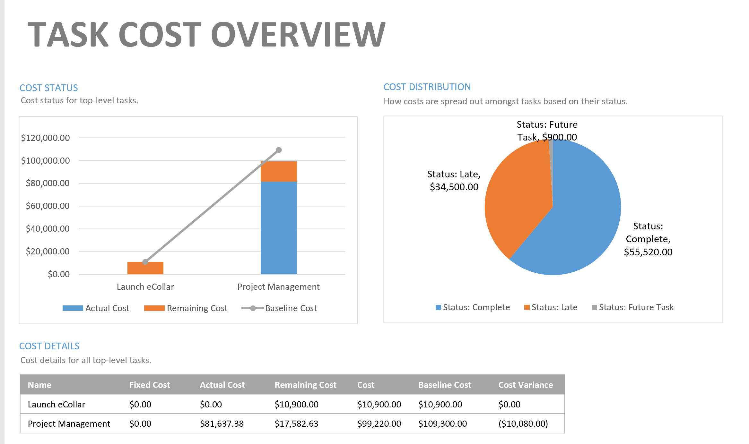
Reporting period
4/19/21 - 6/13/21

Slide 5
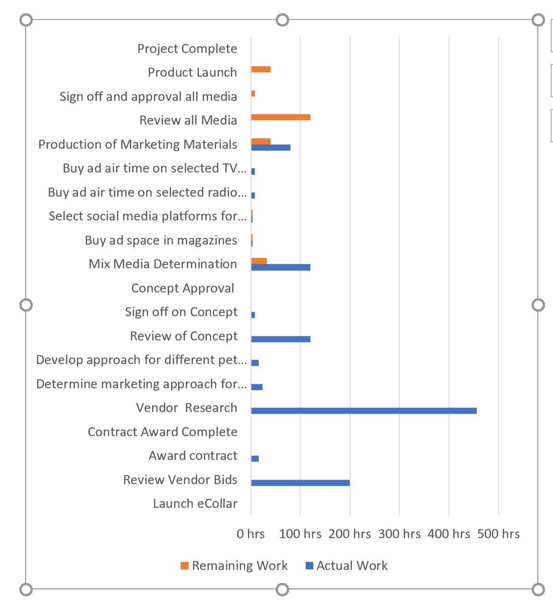
Project summary
Project Started 4/19/21
81% of work is completed
Work to be completed: 3rd party vendor is completing the marketing materials
Next steps: Review and sign off by Pet Technologies of marketing material
Launch Product

Slide 6
Schedule and budget summary
Select Marketing Vendor
Monday 4/19/21 to Friday 4/30/21
Total Cost: $10,900 , Actual Cost: $10,900, Remaining Cost: $0
Vendor Project Work
Tuesday 5/4/21 to Friday 5/21/21
Total Cost: $30,840 , Actual Cost: $30,840, Remaining Cost: $0
Vendor Concept Development
Thursday 5/20/21 to Tuesday 5/25/21
Total Cost: $2,240 , Actual Cost: $2,240, Remaining Cost: $0
Review and Approval of Concept
Wednesday 5/26/21 to Friday 5/28/21
Total Cost: $ 6,660, Actual Cost: $6,660, Remaining Cost: $0
Marketing Collateral
Tuesday 6/1/21 to Monday 6/14/21
Total Cost: $9,160, Actual Cost: $7,080, Remaining Cost: $2,080
Ad Space and Air Time
Monday 6/7/21 to Tuesday 6/15/21
Total Cost: $12,760 , Actual Cost: $8,640, Remaining Cost: $4,120
Review and Approval of Marketing Collateral
Wednesday 6/16/21 to Tuesday 6/22/21
Total Cost: $7,460 , Actual Cost: $0, Remaining Cost: $7,460

Slide 7
Accomplishments
Selected Marketing Vendor
Vendor Completed Project Work
Vendor Developed Concepts
Concepts were Reviewed and Approved
Marketing Collateral is Being Developed*
Ad Space and Air Time*
Review and Approval of Marketing Collateral*

Slide 8
Anticipated Risks – E-collar
Product will not be attractive to target audience.
Ad Jungle marketing will exceed the estimated budget and time.
Outsourced creative collateral will not be delivered in time.
Ad Jungle has a small staff and if they lose a critical employee, it could delay the project.
The cost to market the product will make the monthly fee too high to be attractive to consumers.
Will not be able to compete with price point.
The demand for the product will be greater than ability to manufacture.

Slide 9
Issues and resolutions
Issue #1 – Not desirable by target audience.
Through customer feedback calls we realized we needed to be inclusive of cats as well as dogs
Resolved this issue by quickly pivoting marketing collateral and extending project timeline to allow for packaging changes
Ad Jungle lost an employee during marketing collateral design
Our marketing lead at Ad Jungle quickly adapted and shifted another team member onto our project
Demand for product will be greater than ability to manufacture
Because we conducted such in depth market analysis, we realized we had severely under-planned for the amount of product needed
When extending our timeline to include cats, we were also able to add in additional time for manufacturing

Slide 10

Lessons learned Pet Technologies Inc.
Find vendors who share similar values and create a strong, trusting relationship with them
Conduct an abundance of market analysis and customer feedback calls before making major decisions on project timeline, product specifics, and amount
Understand limitations of reach and plan for future updates, releases, and improvements rather than derailing the project multiple times

